Slide 1
FAKE SOCIAL MEDIA PROFILE DETECTION AND REPORTING
PIP4004 Capstone Project
Review-2
Batch Number: 81
Under the Supervision of,
Ms. Amirtha Preeya Venkatacahalam,
Assistant Professor
School of Computer and Engineering
Presidency University
Roll Number | Student Name
20211CEI0165 20211CEI0031 20211CEI0033 20211CEI0158 | PATHAN ASMA CHITRA GAYATRHI APPIREDDY VIJETHA GOLLA ANUSHA SAI
Name of the Program: B-TECH(COMPUTER ENGINEERING AI&ML)
Name of the HoD: Dr. Gopal Krishna Shyam
Name of the Program Project Coordinator:
Name of the School Project Coordinators: Dr. Sampath A K / Dr. Abdul Khadar A / Mr. Md Ziaur Rahman

Slide 2
Content
Problem Statement
Github Link
Analysis of Problem Statement
Timeline of the Project
References

Slide 3
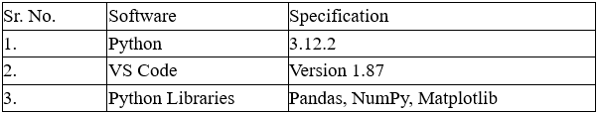
Problem Statement Number: PSCS 81
Category (Software )
Problem Description:
The social life of everyone has become associated with the online social net works. These sites have made a drastic change in the way we pursue our social life. Making friends and keeping in contact with them and their updates has become easier. But with their rapid growth, many problems like fake profiles, online impersonation have also grown.

Slide 4
Analysis of Problem Statement
With the increasing number of Instagram users, fake profiles have become a significant issue. These fake accounts are often used for spam, phishing, misinformation, and cybercrimes. Detecting them manually is difficult due to the large volume of accounts. Machine learning provides an automated approach to classify and detect fake profiles effectively.
Spam & Scams: Fake accounts promote scams, phishing links, and fraudulent advertisements.

Slide 5
Analysis of Problem Statement (contd...)
Misinformation: Fake profiles spread false information, influencing public perception.
Cyberbullying & Harassment: Some fake accounts are used for malicious activities like cyberbullying.
Improve detection accuracy using multiple ML algorithms like Decision Trees, Random Forest, SVM, and Neural Networks.
Develop a machine learning model to detect fake Instagram profiles based on user data.

Slide 6
Analysis of Problem Statement (contd...)
Law enforcement agencies, crime branches, and investigative organizations require an automated system that can efficiently detect such profiles with high accuracy.
Machine learning provides an automated approach to classify and detect fake profiles effectively..

Slide 7
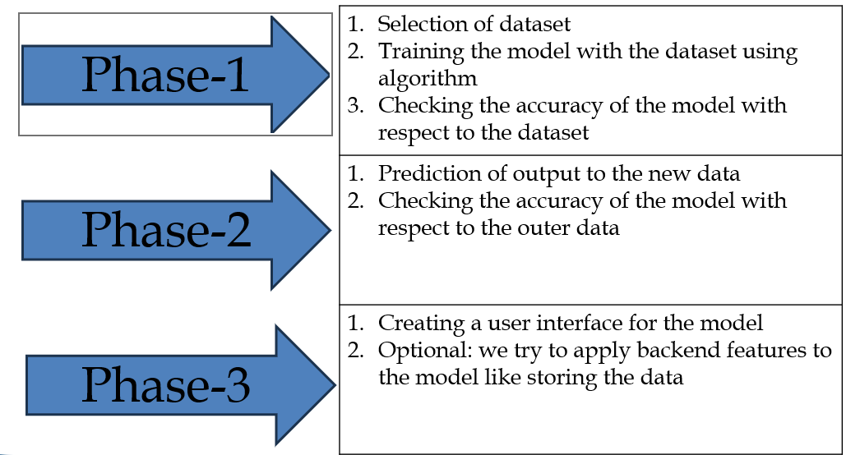
Timeline of the Project

Slide 8
Github Link
The Github link provided with public access permission.
Github Link
https://github.com/Asma603

Slide 9
References (IEEE Paper format)
https://www.scirp.org/journal/paperinformation?paperid=120727
Collage senior's
Collage Faculty
Collage Library

Slide 10


